Slide 1
Modern Structured Analysis
Draw a context DFD to establish initial project scope.
Notes:
Teaching Notes
Although this process may not be as familiar to some adopters as the top-down, fully leveled, classical “physical-logical-logical-physical” approach in the 1976 DeMarco methodology, this is the more contemporary approach and is taught in our book. The original approach is rarely, if ever, practiced because it is so labor intensive and time consuming.

Slide 2
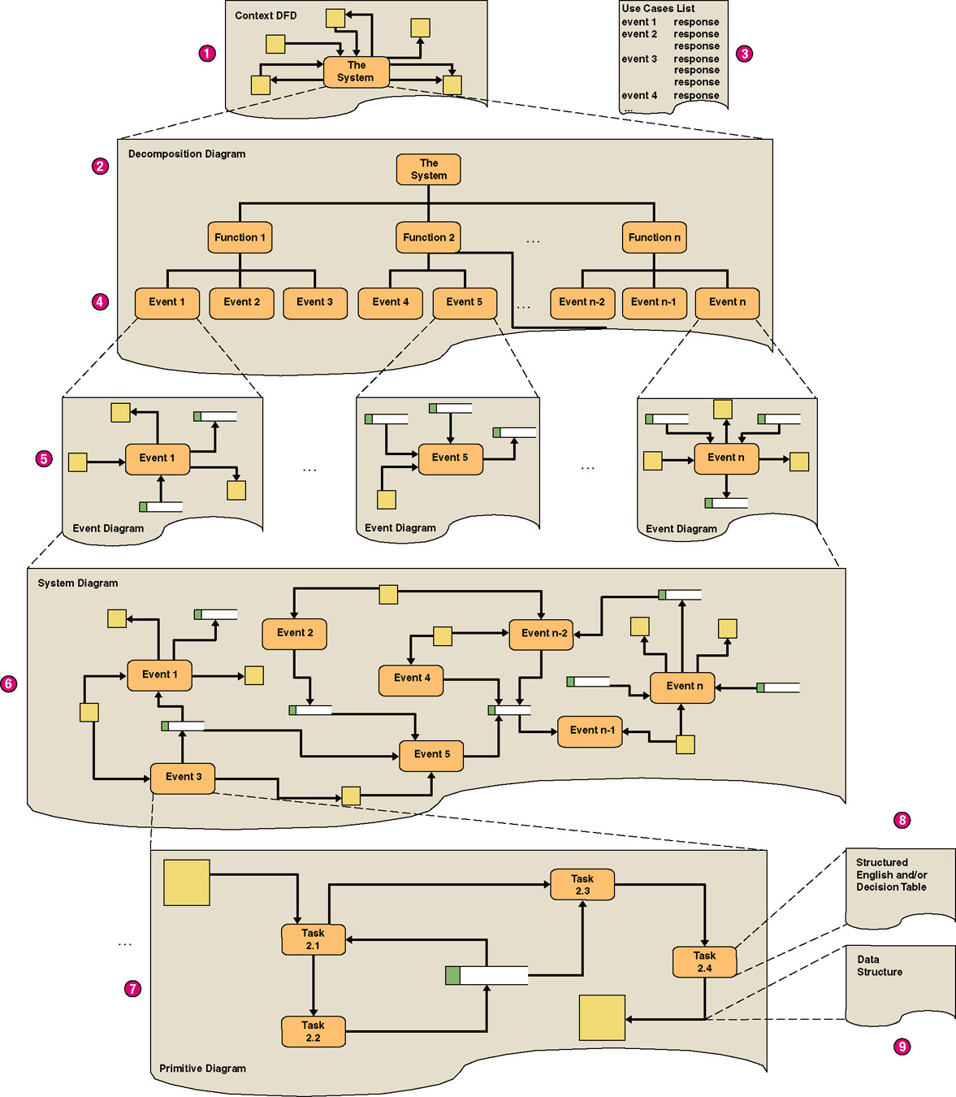
Structured Analysis Diagram Progression (1 of 3)
Notes:
No additional notes.

Slide 3
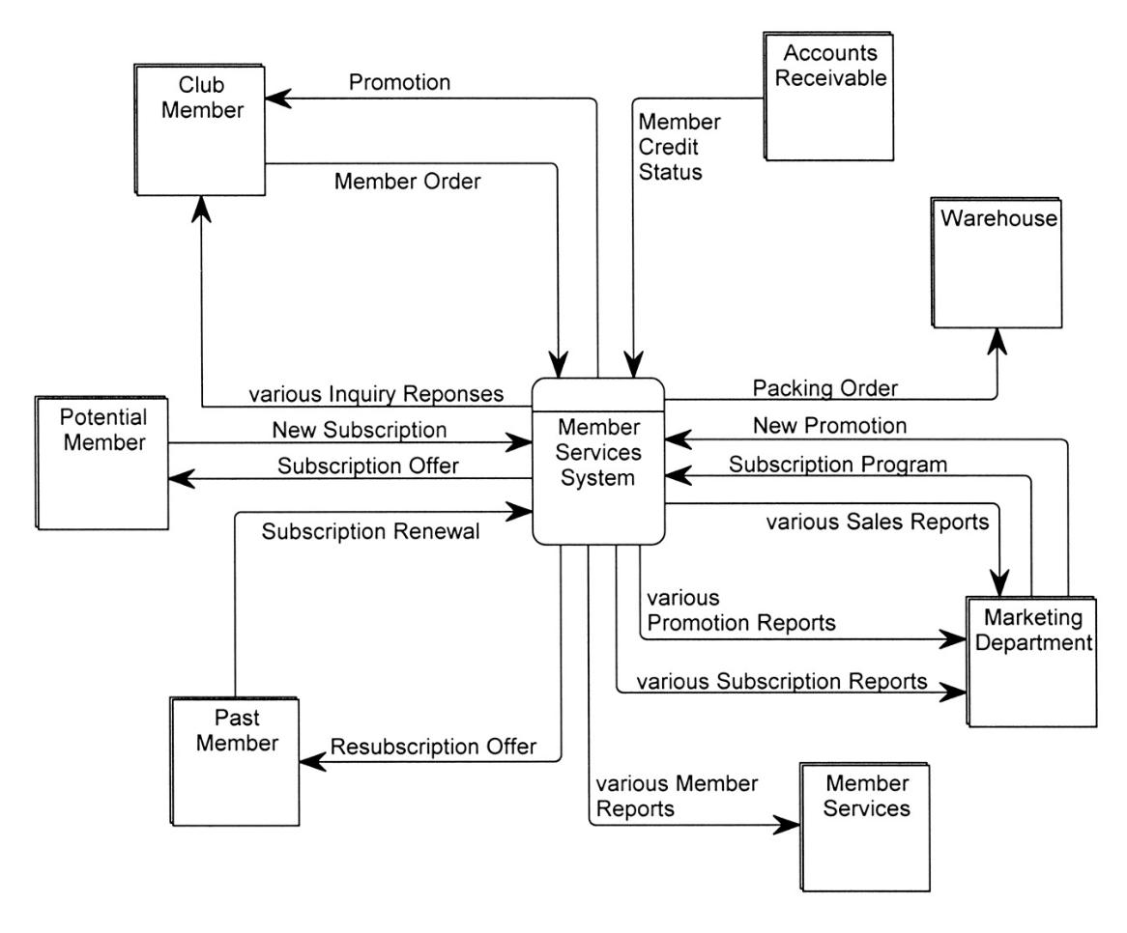
SoundStage Context DFD
Notes:
Teaching Notes
Emphasize that a context DFD does not have to show every net data flow. For most systems, that would overwhelm the reader. Trivial or less common flows can be omitted until later diagrams, and composite data flows can be created to combine multiple flows. As a result, and in the strictest sense, not all primitive data flows may “balance” up to the context DFD, but we sacrifice that balancing to improve readability and validation. All data flows on the context DFD will balance down to the lower-level DFDs (although composite data flows will be replaced by their separate component data flows).

Slide 4
Modern Structured Analysis
Draw a context DFD to establish initial project scope.
Draw a functional decomposition diagram to partition the system into subsystems.
Notes:
Teaching Notes
Although this process may not be as familiar to some adopters as the top-down, fully leveled, classical “physical-logical-logical-physical” approach in the 1976 DeMarco methodology, this is the more contemporary approach and is taught in our book. The original approach is rarely, if ever, practiced because it is so labor intensive and time consuming.

Slide 5
Structured Analysis Diagram Progression (1 of 3)
Notes:
No additional notes.

Slide 6
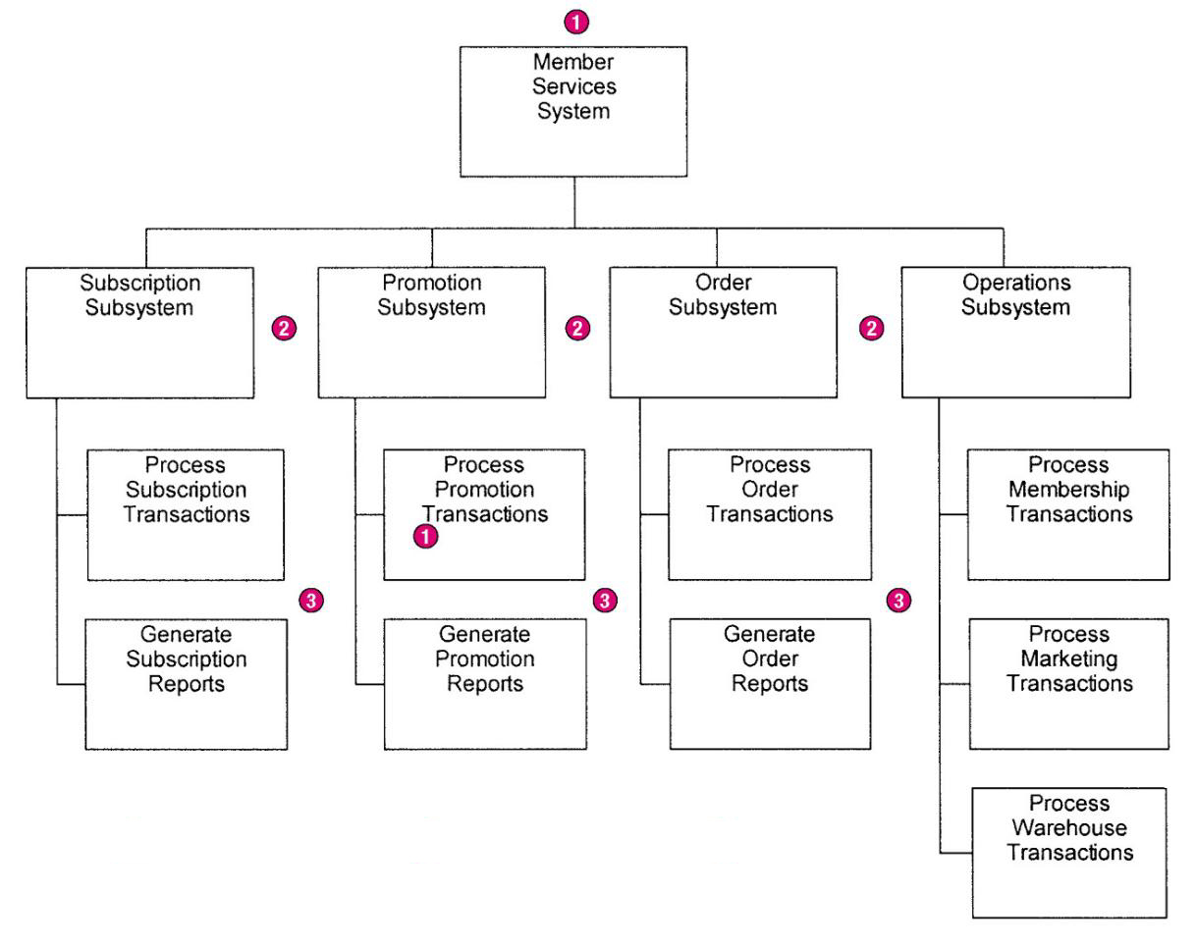
SoundStage Functional Decomposition Diagram
Notes:
No additional notes.

Slide 7
Modern Structured Analysis
Draw a context DFD to establish initial project scope.
Draw a functional decomposition diagram to partition the system into subsystems.
Create an event-response or use-case list for the system to define events for which the system must have a response.
Notes:
Teaching Notes
Although this process may not be as familiar to some adopters as the top-down, fully leveled, classical “physical-logical-logical-physical” approach in the 1976 DeMarco methodology, this is the more contemporary approach and is taught in our book. The original approach is rarely, if ever, practiced because it is so labor intensive and time consuming.

Slide 8
Structured Analysis Diagram Progression (1 of 3)
Notes:
No additional notes.

Slide 9
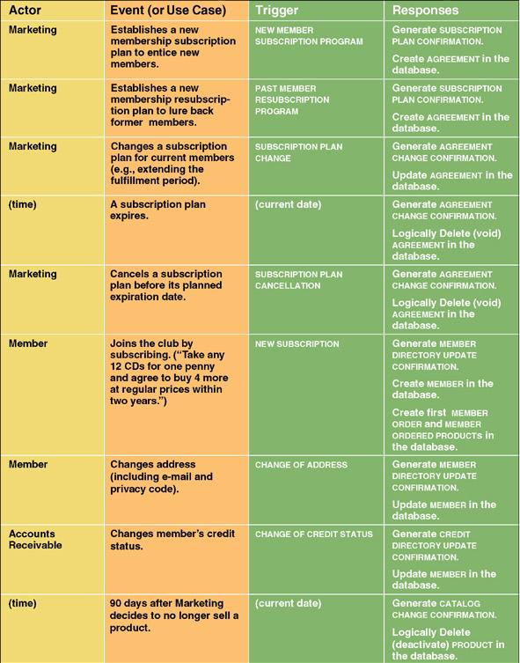
Use Case List
Notes:
No additional notes.

Slide 10
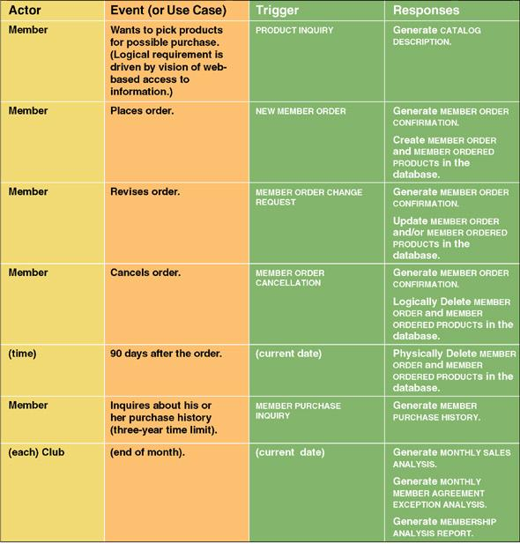
Use Case List (continued)
Notes:
No additional notes.

Slide 11
Modern Structured Analysis
Draw a context DFD to establish initial project scope.
Draw a functional decomposition diagram to partition the system into subsystems.
Create an event-response or use-case list for the system to define events for which the system must have a response.
Draw an event DFD (or event handler) for each event.
Notes:
Teaching Notes
Although this process may not be as familiar to some adopters as the top-down, fully leveled, classical “physical-logical-logical-physical” approach in the 1976 DeMarco methodology, this is the more contemporary approach and is taught in our book. The original approach is rarely, if ever, practiced because it is so labor intensive and time consuming.

Slide 12
Structured Analysis Diagram Progression (1 of 3)
Notes:
No additional notes.

Slide 13
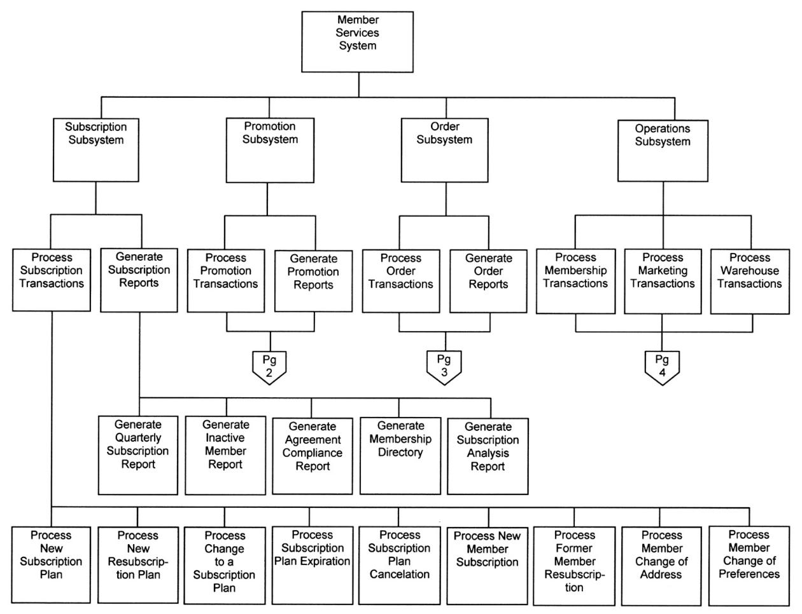
Event Decomposition Diagram (partial)
Notes:
Teaching Notes
Most event decomposition diagrams will require multiple pages (or one very large plotter-style page) because most systems are required to respond to many events (possibly dozens or hundreds).

Slide 14
Structured Analysis Diagram Progression (2 of 3)
Notes:
No additional notes.

Slide 15
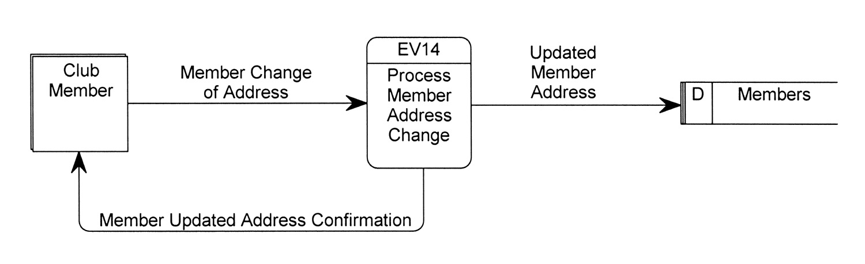
External Event DFD
Event diagram – data flow diagram that depicts the context for a single event.
Notes:
No additional notes.

Slide 16
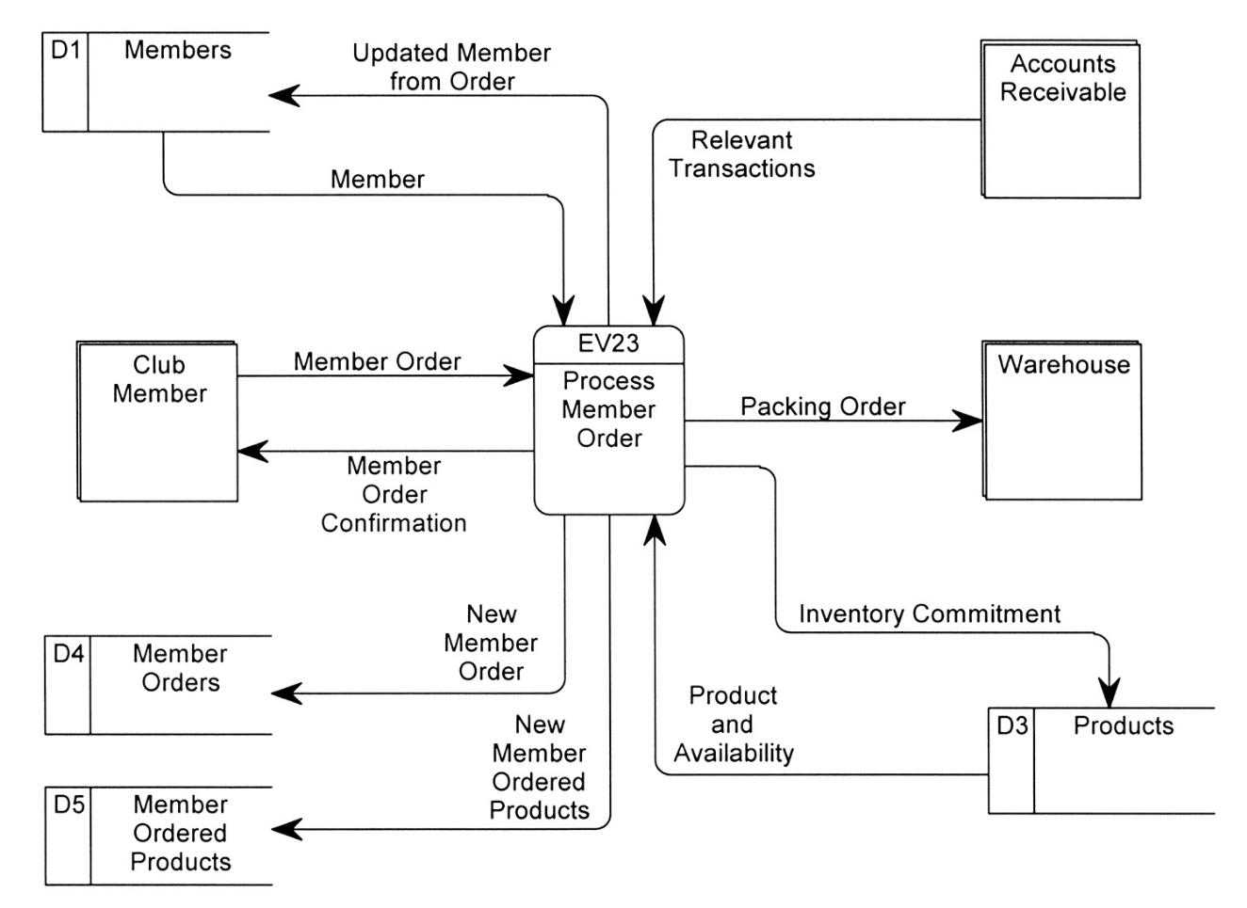
External Event DFD (more complex)
Notes:
No additional notes.

Slide 17
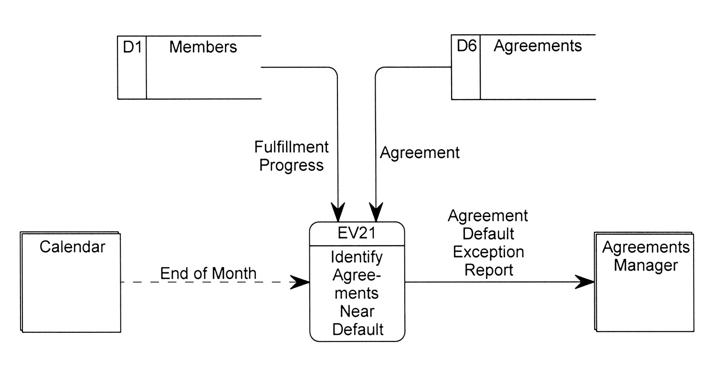
Temporal Event DFD
Notes:
No additional notes.

Slide 18
Modern Structured Analysis
Draw a context DFD to establish initial project scope.
Draw a functional decomposition diagram to partition the system into subsystems.
Create an event-response or use-case list for the system to define events for which the system must have a response.
Draw an event DFD (or event handler) for each event.
Merge event DFDs into a system diagram (or, for larger systems, subsystem diagrams).
Notes:
Teaching Notes
Although this process may not be as familiar to some adopters as the top-down, fully leveled, classical “physical-logical-logical-physical” approach in the 1976 DeMarco methodology, this is the more contemporary approach and is taught in our book. The original approach is rarely, if ever, practiced because it is so labor intensive and time consuming.

Slide 19
Structured Analysis Diagram Progression (2 of 3)
Notes:
No additional notes.

Slide 20
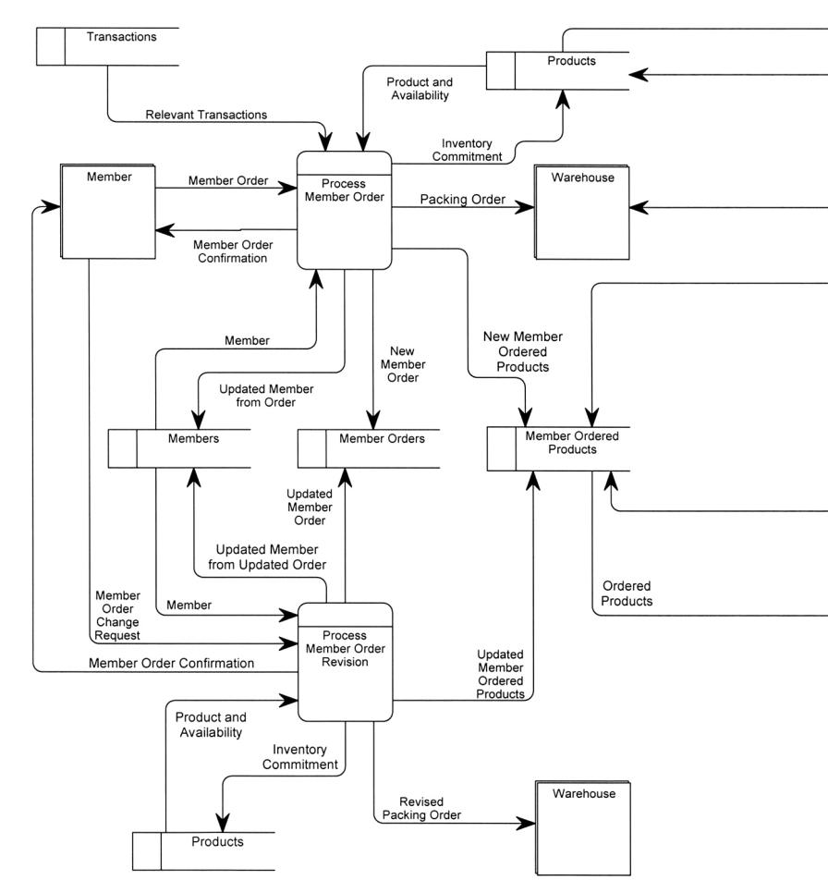
System DFD
Notes:
Teaching Notes
Most system DFDs will not fit on one or two pages—too many event processes. Instead they must be illustrated in a series of system diagrams that correspond to the structure originally depicted in the functional decomposition diagram.

Slide 21
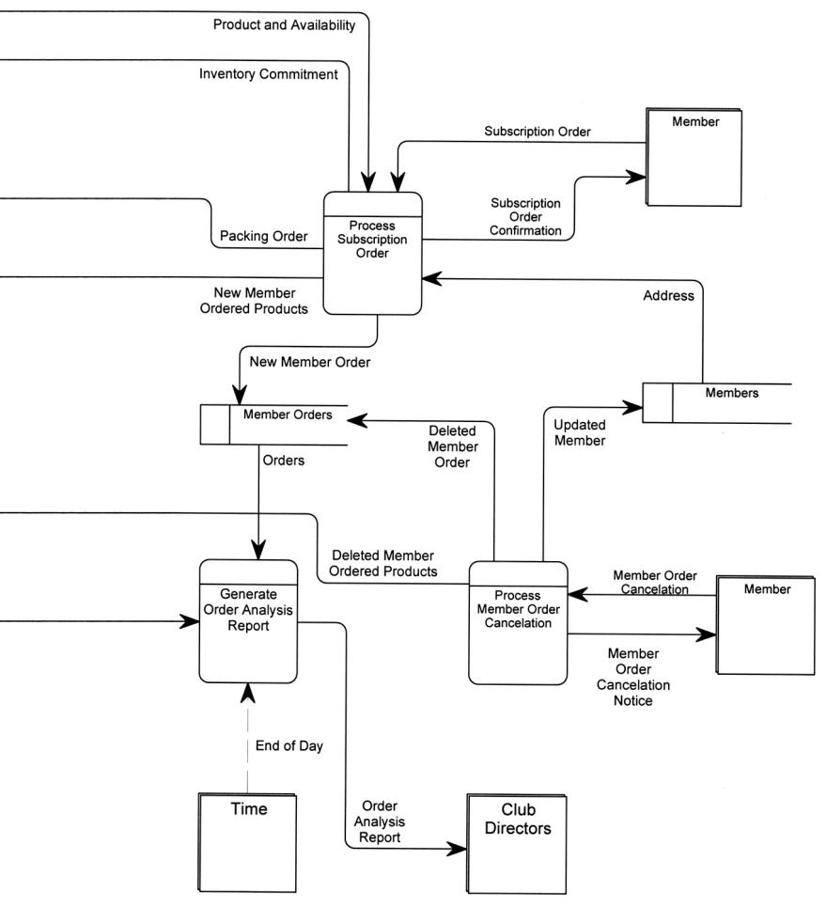
System DFD
Notes:
Teaching Notes
Discuss balancing with the class, the concept that requires that data flow diagrams at different levels of detail reflect consistency and completeness.

Slide 22
Modern Structured Analysis
Draw a context DFD to establish initial project scope.
Draw a functional decomposition diagram to partition the system into subsystems.
Create an event-response or use-case list for the system to define events for which the system must have a response.
Draw an event DFD (or event handler) for each event.
Merge event DFDs into a system diagram (or, for larger systems, subsystem diagrams).
Draw detailed, primitive DFDs for the more complex event handlers.
Document data flows and processes in the data dictionary.
THE ABOVE METHODOLOGY, BASED ON EVENT PARTITIONING, IS MORE COMMONLY PRACTICED.
Notes:
Teaching Notes
Although this process may not be as familiar to some adopters as the top-down, fully leveled, classical “physical-logical-logical-physical” approach in the 1976 DeMarco methodology, this is the more contemporary approach and is taught in our book. The original approach is rarely, if ever, practiced because it is so labor intensive and time consuming.

Slide 23
Structured Analysis Diagram Progression (2 of 3)
Notes:
No additional notes.

Slide 24
Structured Analysis Diagram Progression (3 of 3)
Notes:
No additional notes.

Slide 25
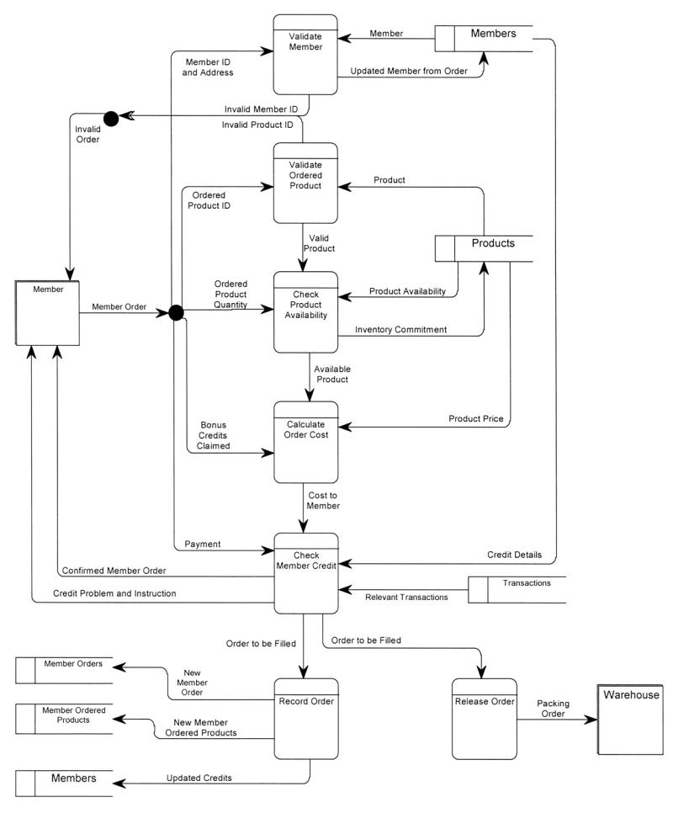
Primitive DFD (see book for more readable copy)
Notes:
Teaching Notes
It is important to recognize that not all events require a primitive DFD to be drawn. This is especially true of most report-writing and inquiry response event processes. Drawing detailed DFDs for such processes is usually little more than “busy work.”

